Slide 1
Machine Learning Heresy
and the
Church of Optimality
Evan Estola
3/9/17

Slide 2
About Me
Evan Estola
Staff Machine Learning Engineer, Data Team Lead @ Meetup
evan@meetup.com
@estola

Slide 3
Meetup
Do more of what’s most important to you
270,000 Meetups, ~30 million members
Recommendations
Cold Start
Sparsity
Lies

Slide 4
Data Science impacts lives
Ads you see
Friend’s Activity/Facebook feed
News you’re exposed to
If a product is available
If you can get a ride
Price you pay for things
Admittance into college
If you can get a loan
Job openings you find
Job openings you can get
Punishment for crime
Notes:
Some of these things are not trivial but rather serious impact your life stuff

Slide 5
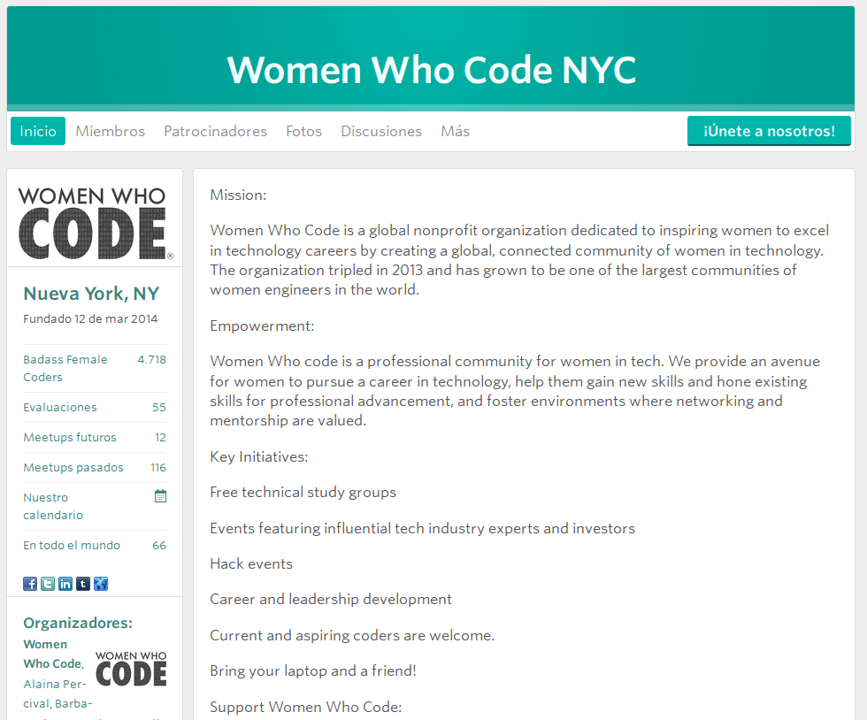

Slide 6
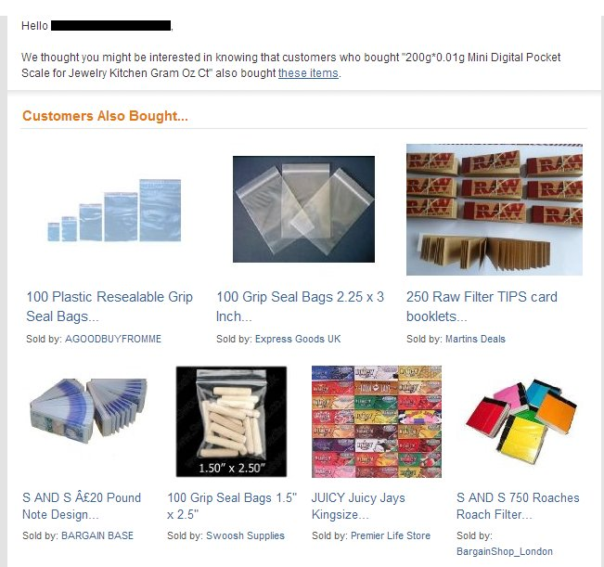
You just wanted a kitchen scale, now Amazon thinks you’re a drug dealer

Slide 7
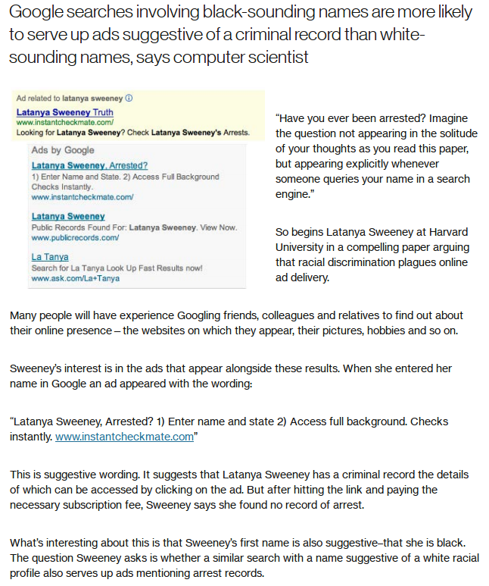
“Black-sounding” names 25% more likely to be served ad suggesting criminal record

Slide 8
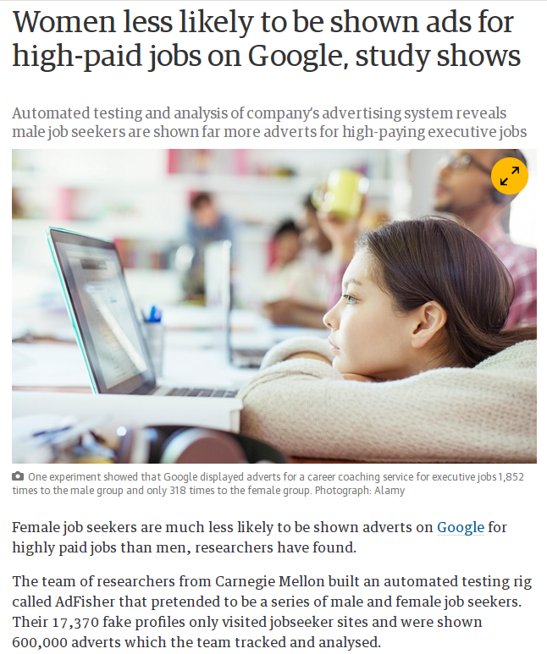
Fake profiles, track ads
Career coaching for “200k+” Executive jobs Ad
Male group: 1852 impressions
Female group: 318

Slide 9
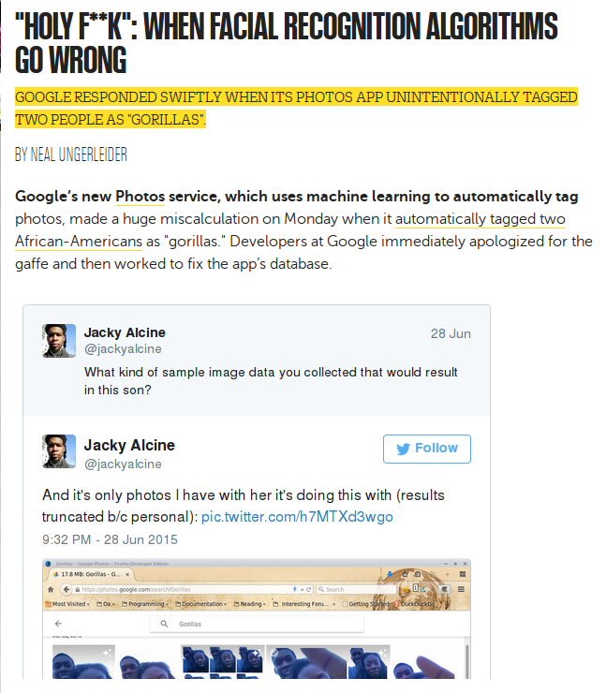

Slide 10
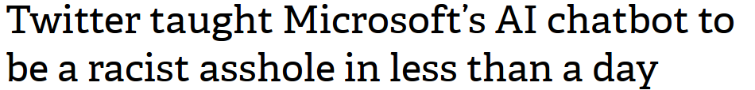
Tay.ai
Twitter bot
“Garbage in, garbage out”
Responsibility?
“In the span of 15 hours Tay referred to feminism as a "cult" and a "cancer," as well as noting "gender equality = feminism" and "i love feminism now." Tweeting "Bruce Jenner" at the bot got similar mixed response, ranging from "caitlyn jenner is a hero & is a stunning, beautiful woman!" to the transphobic "caitlyn jenner isn't a real woman yet she won woman of the year?"”

Slide 11
You know racist computers are a bad idea
Don’t let your company invent racist computers
@estola

Slide 12
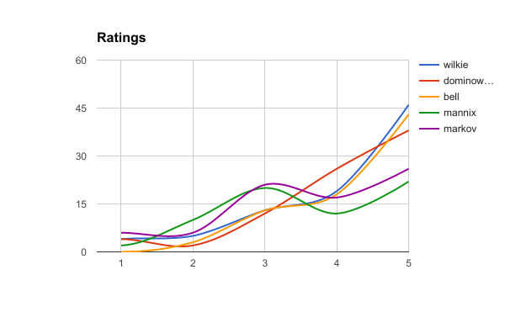

Slide 13
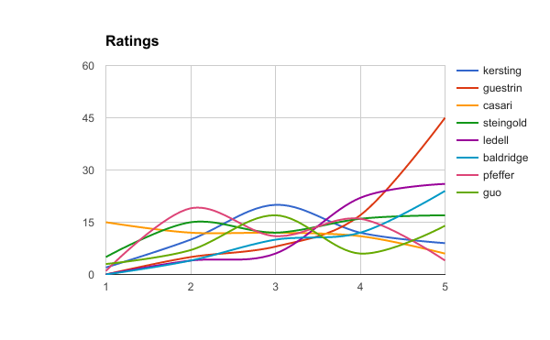

Slide 14
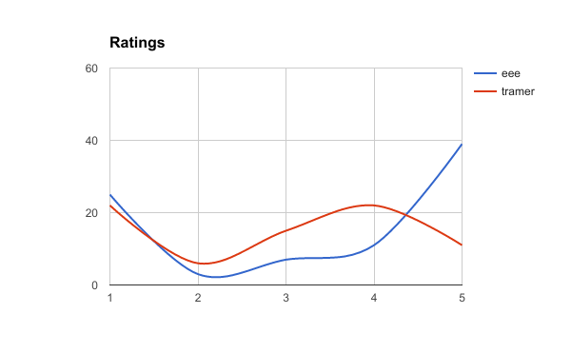

Slide 15
Brief Math Aside
Summary statistics are crap on multimodal distributions
“there is no presently generally agreed summary statistic (or set of statistics) to quantify the parameters of a general bimodal distribution”

Slide 16
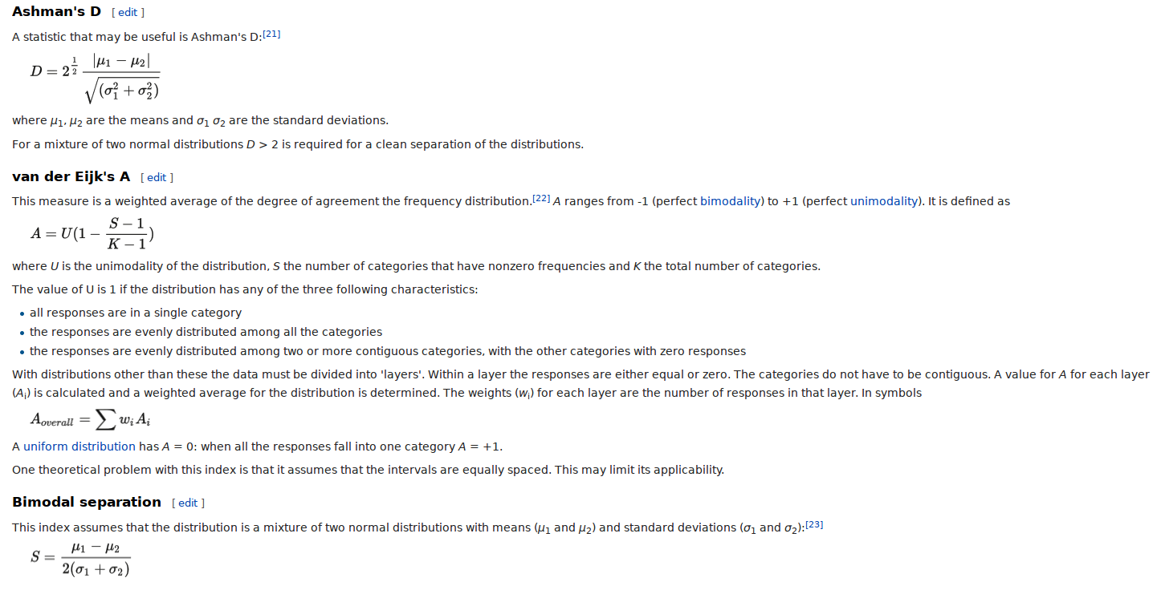

Slide 17
By restricting or removing certain features aren’t you sacrificing performance?
Isn’t it actually adding bias if you decide which features to put in or not?
If the data shows that there is a relationship between X and Y, isn’t that your ground truth?
Isn’t that sub-optimal?

Slide 18
Bad Features
Not all features are ok!
‘Time travelling’
Rating a movie => watched the movie
Went to a Meetup => joined the Meetup

Slide 19
Benign Features
Not all Features are useful!
Member only features don’t affect ranking (in simple models)
Clicked an email => likely to join/rsvp/etc.

Slide 20
“It’s difficult to make predictions, especially about the future”

Slide 21
Misguided Models
Offline performance != Online performance
Predicting past behavior != Influencing behavior
Clicks vs. buy behavior in ads

Slide 22
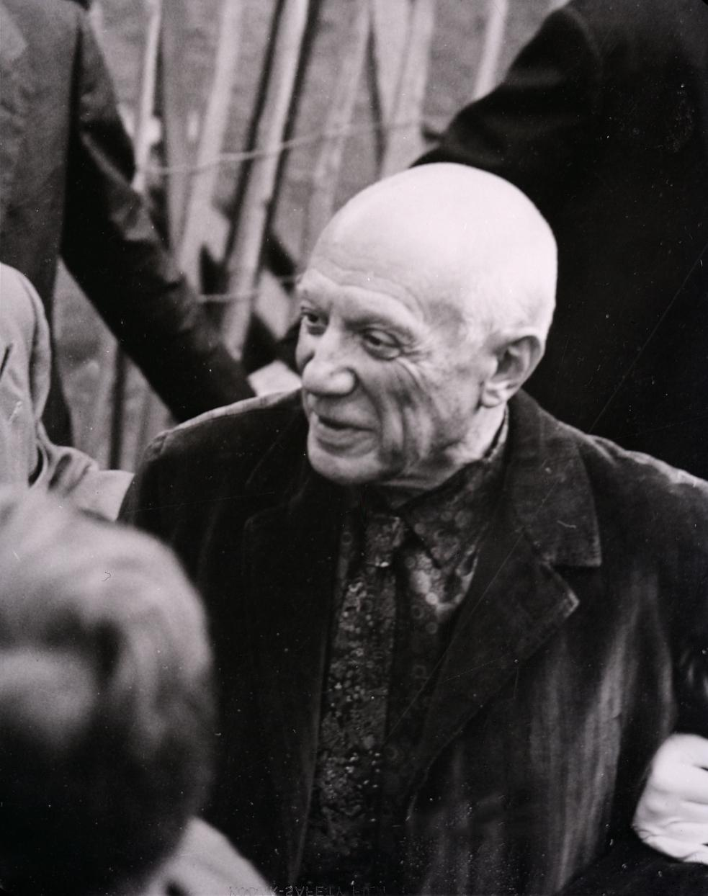
“Computers are useless, they can only give you answers”

Slide 23
Asking the right questions
Need a human
Choosing features
Choosing the right target variable
Value-added ML

Slide 24
Asking the right questions
Need a human
Auto-ethics
Tramer, FairTest
Defining un-ethical features
Who decides to look for fairness in the first place?

Slide 25
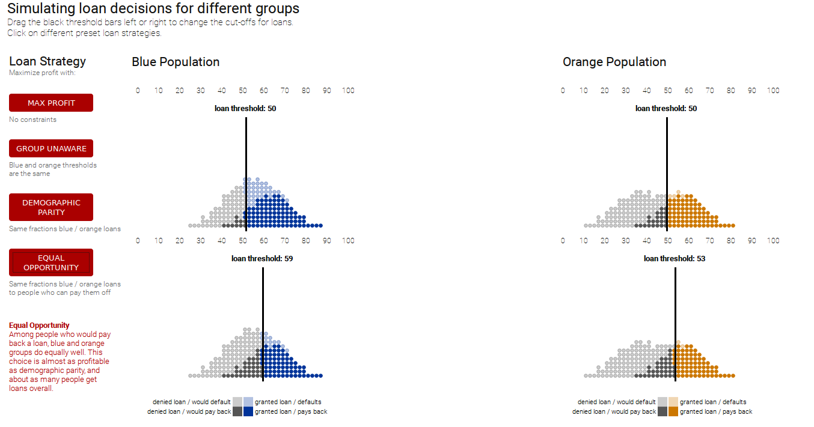
https://research.google.com/bigpicture/attacking-discrimination-in-ml/

Slide 26
Example
Questionable real-world applications
Screen job applications
Screen college applications
Predict salary
Predict recidivism
Features?
Race
Gender
Age

Slide 27
Correlating features
Name -> Gender
Name -> Age
Grad Year -> Age
Zip -> Socioeconomic Class
Zip -> Race
Likes -> Age, Gender, Race, Sexual Orientation...
Credit score, SAT score, College prestigiousness...

Slide 28
At your job...
Not everyone will have the same ethical values, but you don’t have to take ‘optimality’ as an argument against doing the right thing.

Slide 29
“All models are wrong,
but some are useful”
Your model is already biased, it will never be optimal. Don’t turn wisdom into heresy.

Slide 30
MLConf NYC
3/24 ‘Evan18’
@estola
evan@meetup.com

